Slide 1
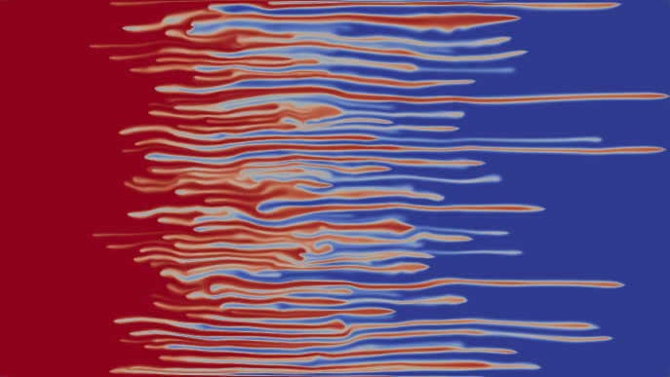




Travelling waves: dynamical perspective
Yulia Petrova PUC-Rio
yulia-petrova.github.io
22 September 2023
Matinê
Based on work in progress with:
Sergey Tikhomirov (PUC-Rio)
Yalchin Efendiev (Texas A&M)

Slide 2
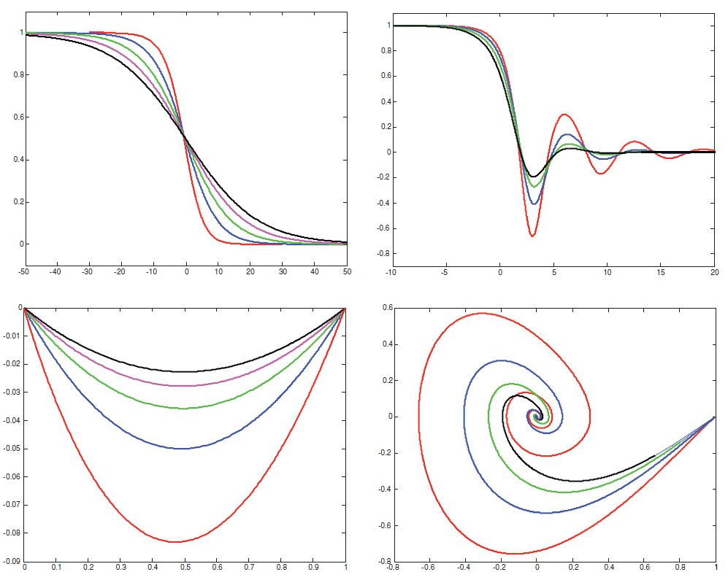
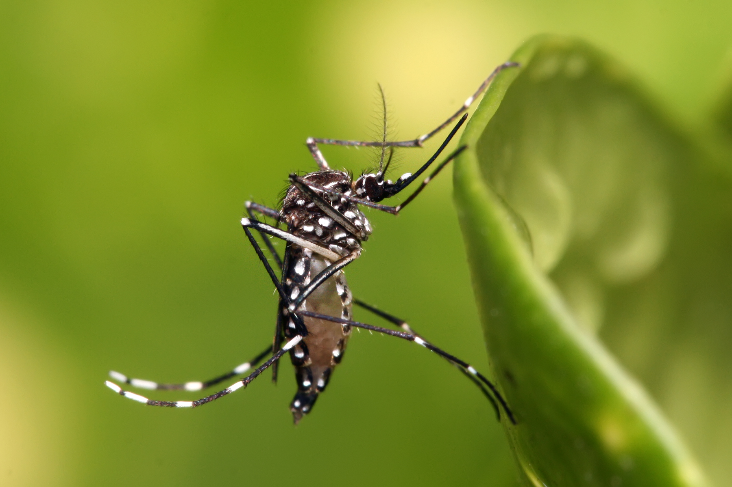
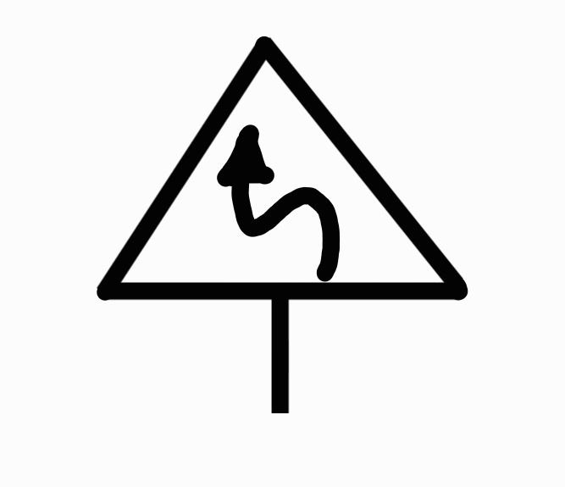
AIM: show how dynamical systems can help PDEs
Population dynamics (spreading of animals)
Travelling waves in PDEs $↔$ Heteroclinic orbits in Dynamical Systems
$$↔$$
Miscible displacement in porous media
Viscous / gravitational fingering: ``toy ’’ model
Formulation (PDEs) : a vida está russa (=complicada)
Proof (…tem o gosto dinâmico!!!)
Work in progress with Sergey Tikhomirov (PUC-Rio) and Yalchin Efendiev (Texas A&M)
1

Slide 3
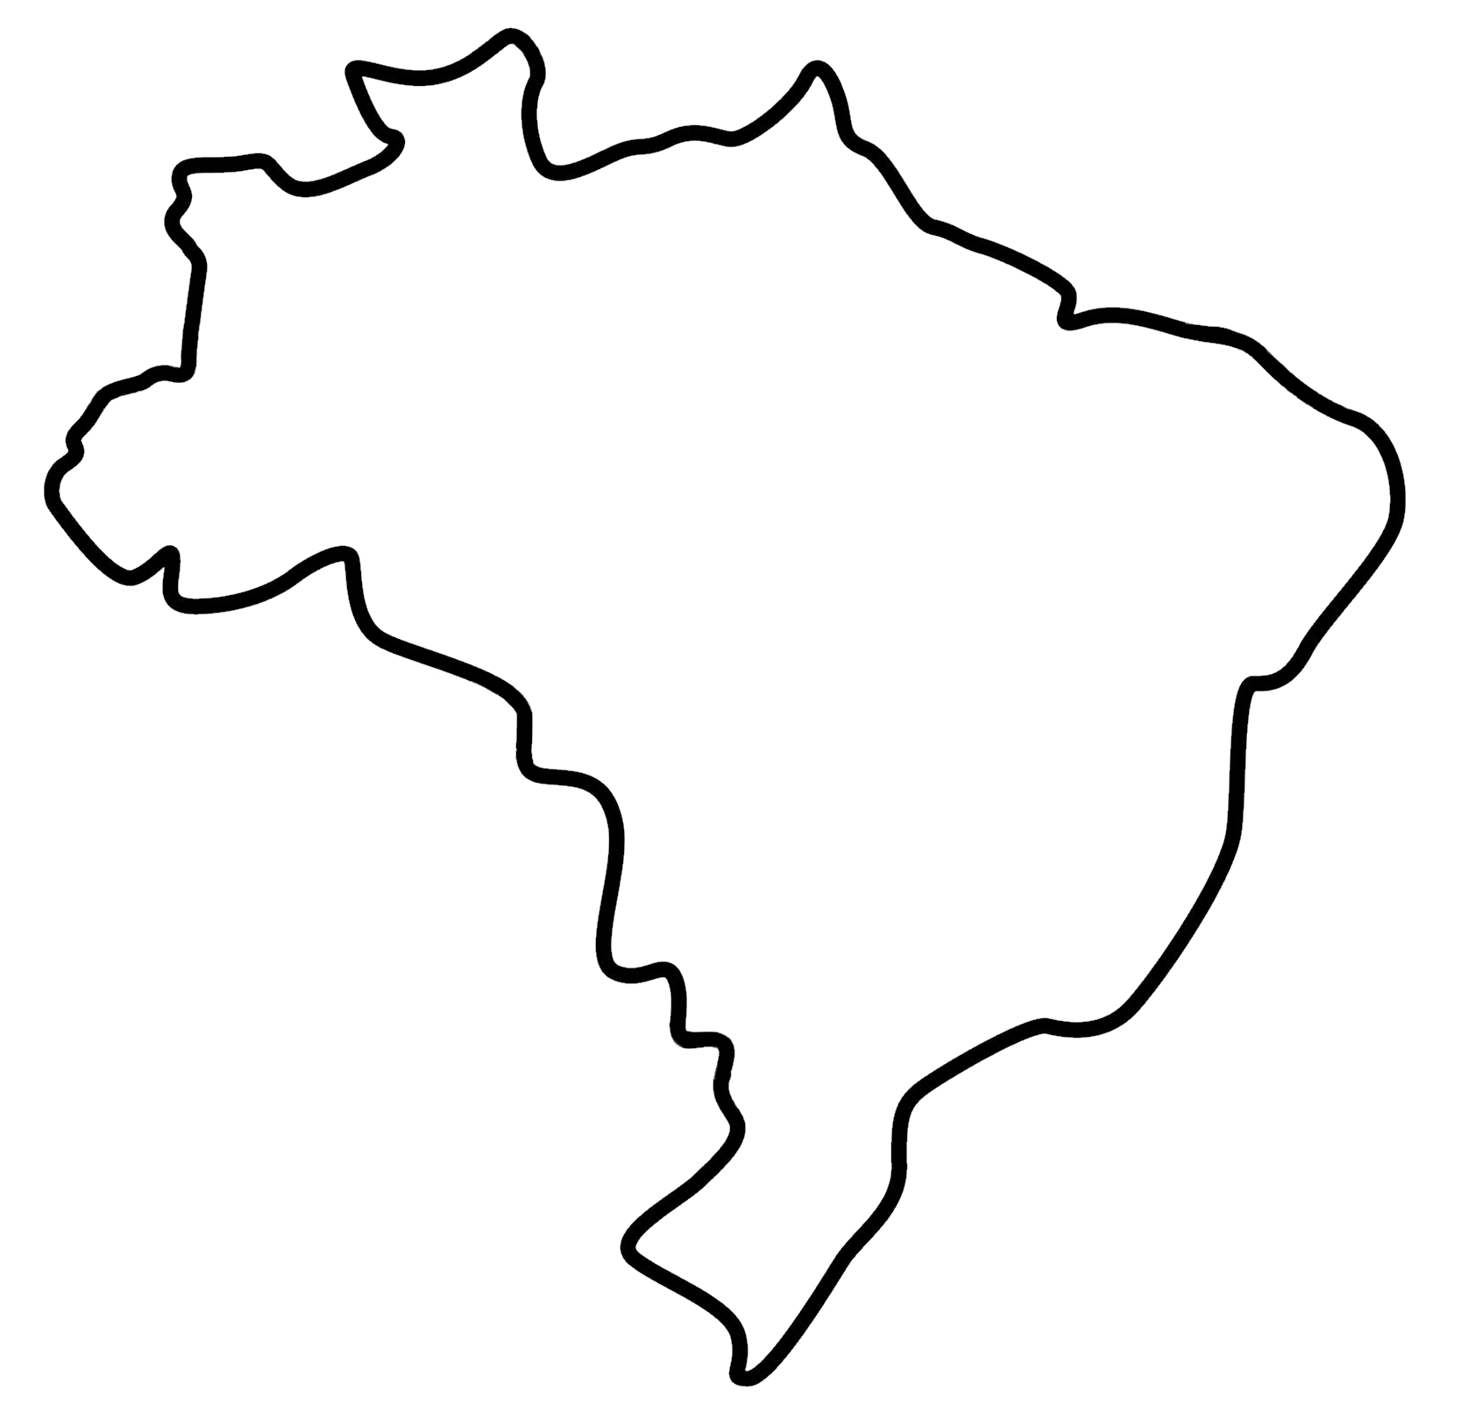
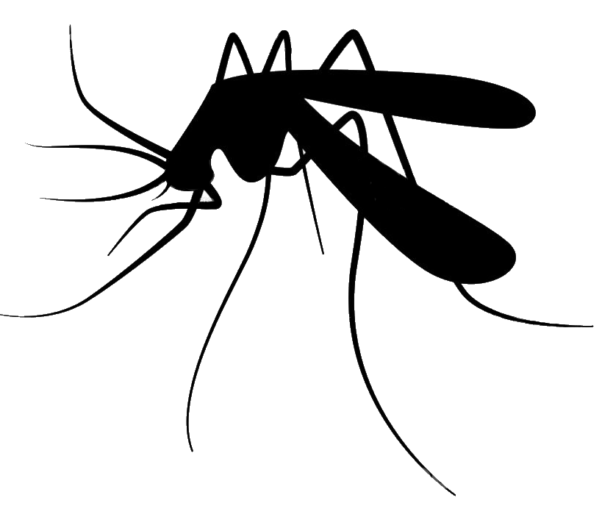
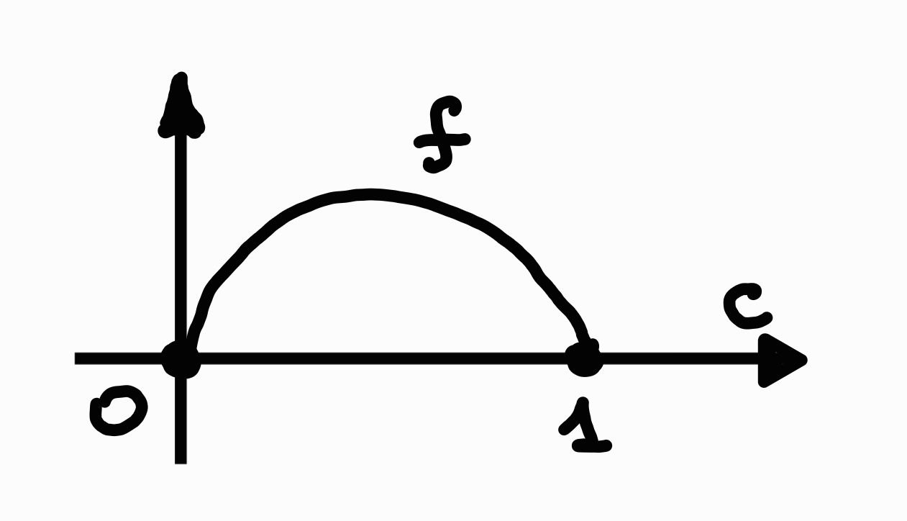
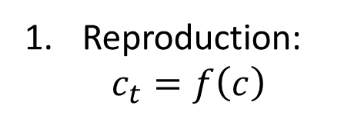
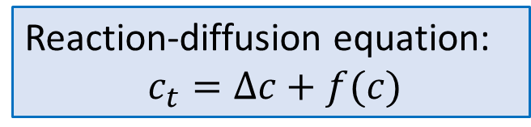
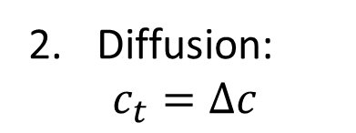
Example 1: population dynamics
spreading of animals
Aedes aegypti
(yellow fever mosquito)
$c\left(x,t\right)∈[0,1]$ – density of population of mosquitoes
propagation due to reproduction and diffusion
Reaction-diffusion equation:
$c_{t}=Δc+f(c)$
Reproduction:
$$c_{t}=f\left(c\right)$$
Diffusion:
$$c_{t}=Δc$$
Aim: understand the behaviour of $c(x,t)$ as $t→∞$
2

Slide 4
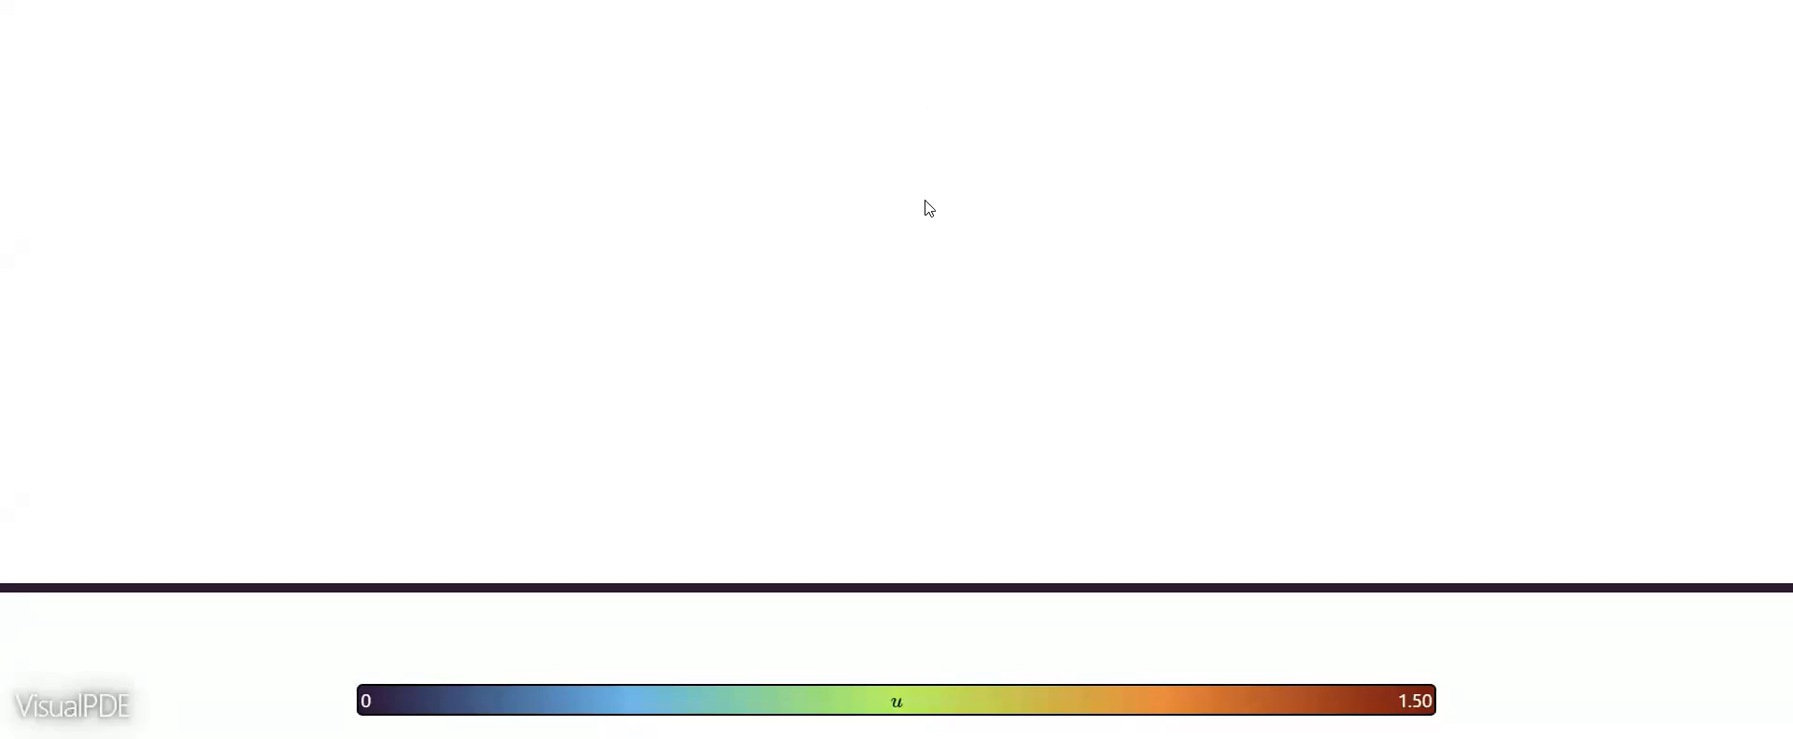
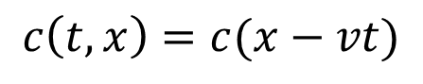
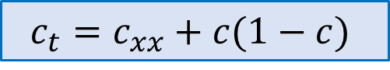
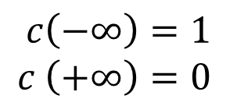
Fisher-KPP equation (for $x∈ℝ$)
“Invasion” occurs!
$$c_{t}=c_{xx}+c(1−c)$$
Question: how to find a speed $v$ of propagation?
Travelling Wave Solution
$$c\left(t,x\right)=c(x−vt)$$
$$c\left(−∞\right)=1$$
$$c \left(+∞\right)=0$$
Credit from https://visualpde.com/
It is a fun - enjoy!
Fisher, R.A., 1937. The wave of advance of advantageous genes. Annals of eugenics, 7(4), pp.355-369.
A.N. Kolmogorov, I.G. Petrovskii and N.S. Piskunov, Etude de l'équation de la diffusion avec croissance de la quantité de matière et son application à un problème biologique, Bulletin Universite d’Etat a Moscou, Serie Internationale, section A 1, 1937, 1–26.
3

Slide 5
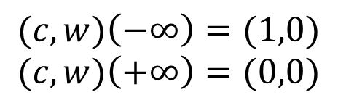
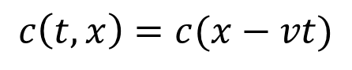
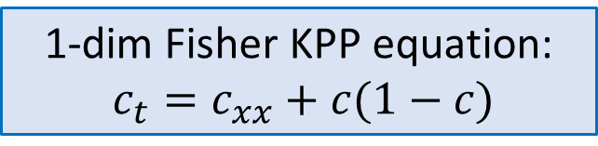
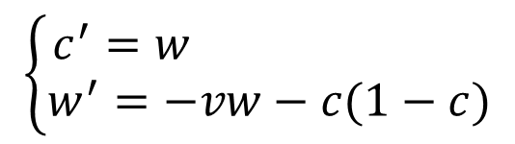
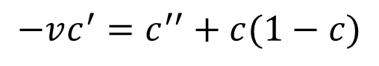
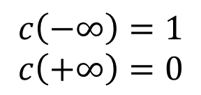
Travelling wave solution
$↔$ Heteroclinic orbit
1-dim Fisher KPP equation:
$c_{t}=c_{xx}+c(1−c)$
Travelling Wave Solution
$$−vc^{′}=c^{′′}+c(1−c)$$
$$c\left(t,x\right)=c(x−vt)$$
$$\left\{\begin{aligned}c^{′}=w \\ w^{′}=−vw−c(1−c)\end{aligned}\right.$$
$$c\left(−∞\right)=1$$
$$c\left(+∞\right)=0$$
with
$$(c,w)\left(−∞\right)=(1,0)$$
$$(c,w)\left(+∞\right)=(0,0)$$
Fixed
points
Take-home message 1:
FINDING TRAVELLING WAVE SOLUTIONS FOR PDE
FINDING HETEROCLINIC (HOMO-) ORBITS IN DYNAMICAL SYSTEM
(sometimes)
4

Slide 6
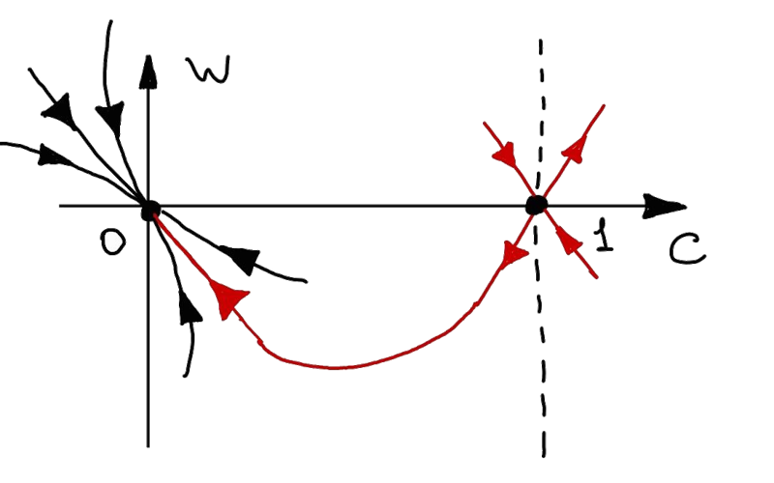
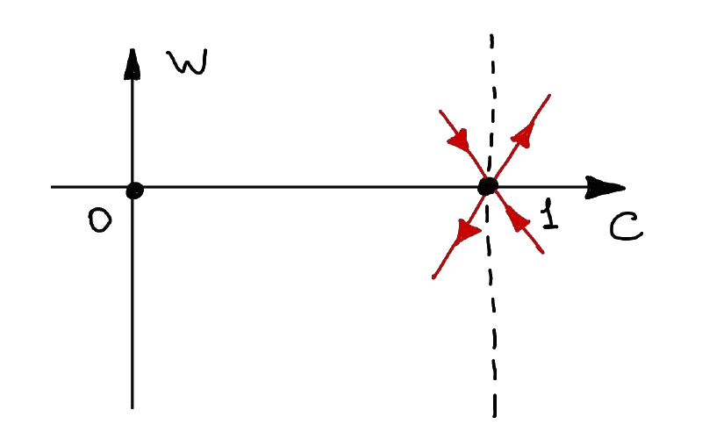
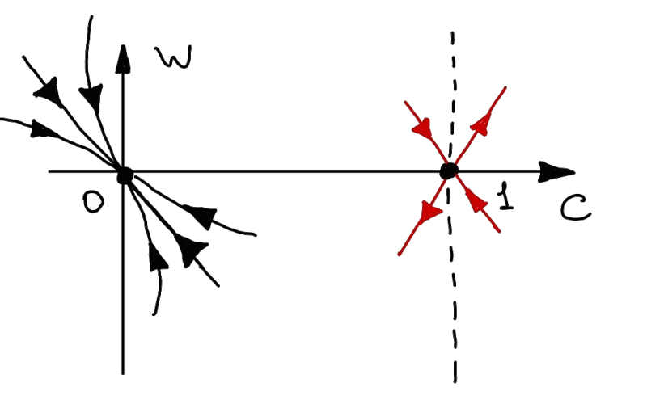
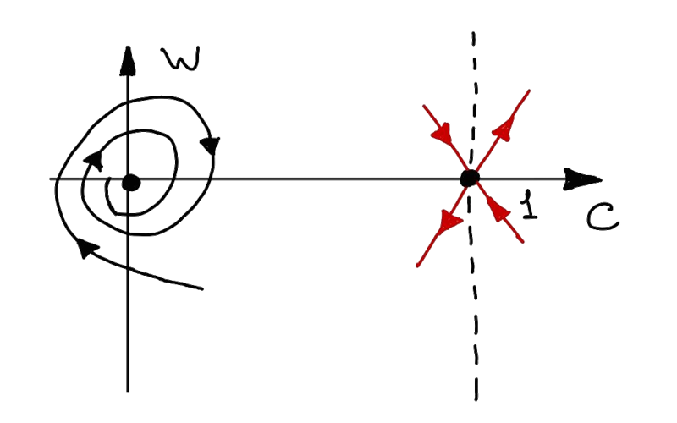
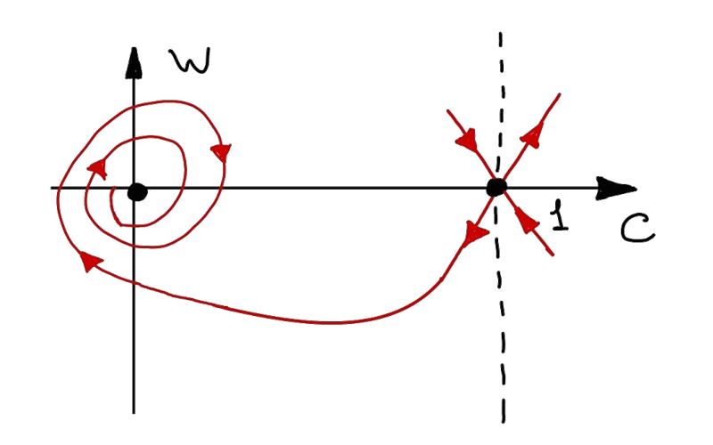
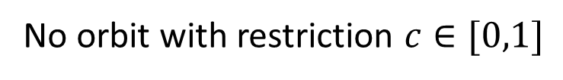
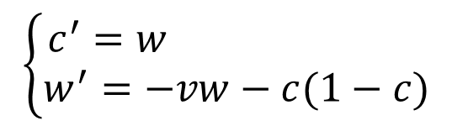
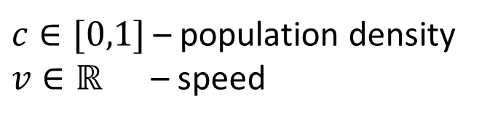
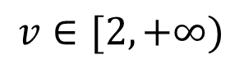
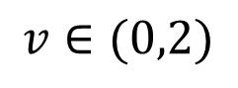
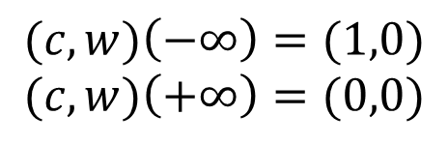

… looking for heteroclinic orbits …
$c∈[0,1]$ – population density
$v∈ℝ$ – speed
$$\left\{\begin{aligned}c^{′}=w \\ w^{′}=−vw−c(1−c)\end{aligned}\right.$$
$$(c,w)\left(−∞\right)=(1,0)$$
$$(c,w)\left(+∞\right)=(0,0)$$
– saddle point
$$v∈(0,2)$$
$$v∈[2,+∞)$$
No orbit with restriction $c∈[0,1]$
For any $v∈\left[2,+∞\right)$ there exists an orbit
5

Slide 7
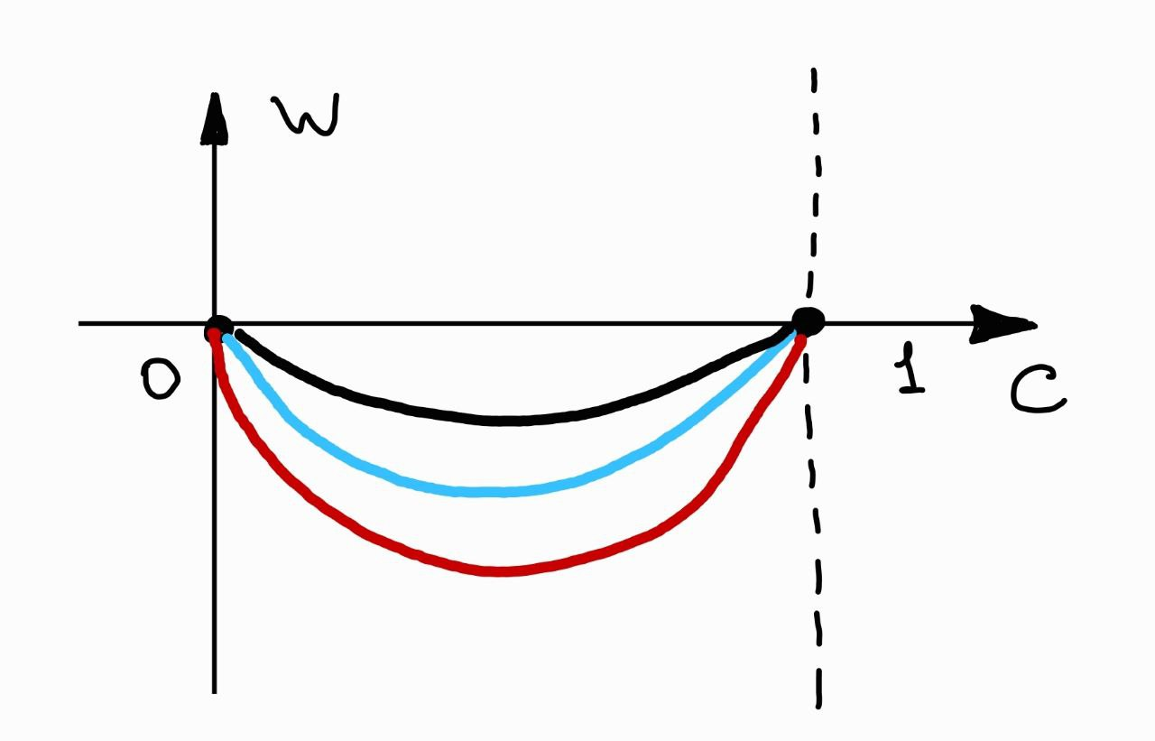
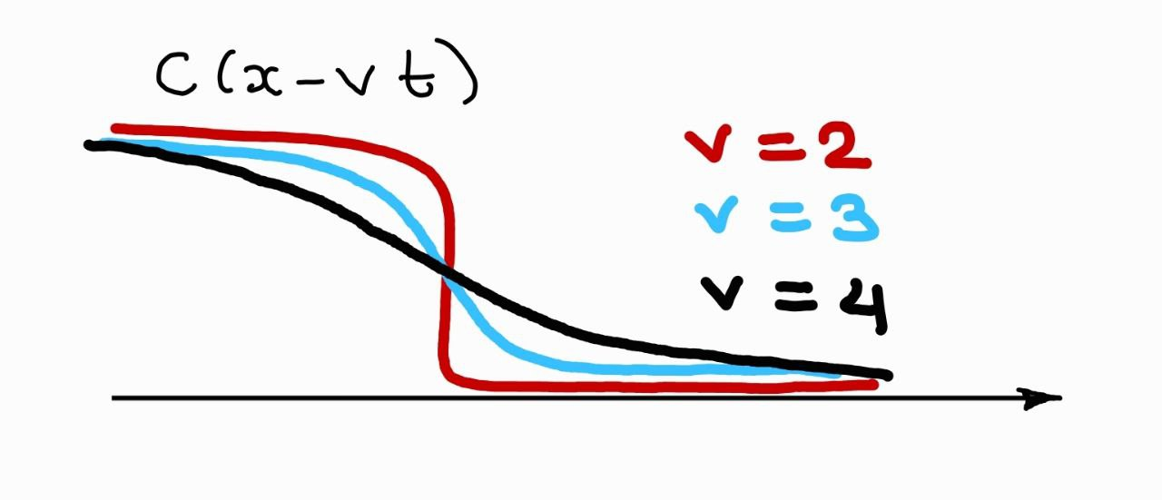
Travelling wave solution (TW) $↔$ Heteroclinic orbit
There exists a family of TW parametrized by speed $v∈[2,∞)$
Questions?
If initial data has compact support, then the limiting TW has speed $v=2$ (the minimal speed) Proof of convergence of solution to the TW is a PDE stuff…
Take-home message 1:
FINDING TRAVELLING WAVE SOLUTIONS FOR PDES
FINDING HOMO-/HETEROCLINIC ORBITS IN DYNAMICAL SYSTEMS
6

Slide 8
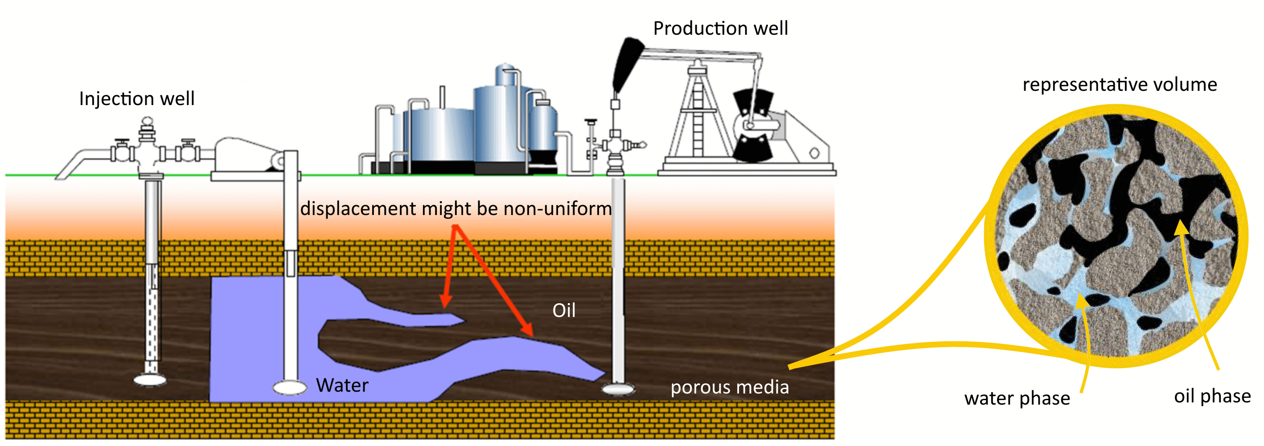
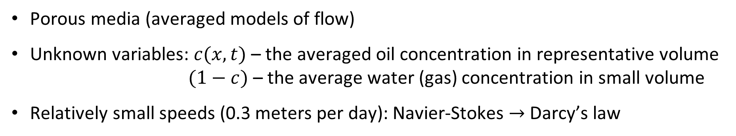
Example 2: motivation from oil recovery
We are interested in the mathematical model of oil recovery
Porous media (averaged models of flow)
Unknown variables: $c(x,t)$ – the averaged oil concentration in representative volume
$(1−c)$ – the average water (gas) concentration in small volume
Relatively small speeds (0.3 meters per day): Navier-Stokes $→$ Darcy’s law
7

Slide 9
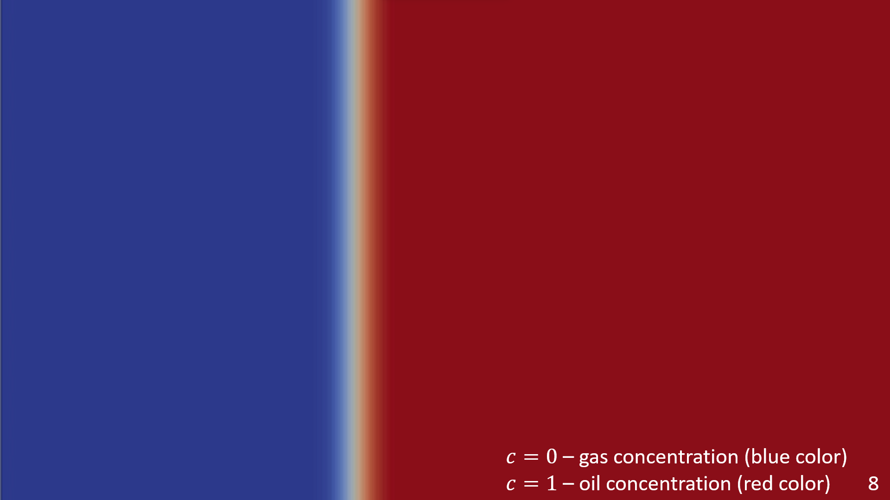

$c=0$ – gas concentration (blue color) $c=1$ – oil concentration (red color)
8

Slide 10
“Miscible displacement in porous media”
Credit: Pavlov Dmitrii, St. Petersburg State University
Viscous fingering phenomenon
$c=0$ – gas concentration (blue color) $c=1$ – oil concentration (red color)
9

Slide 11
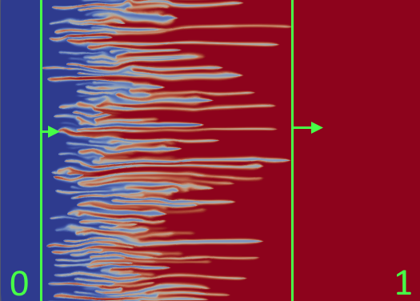
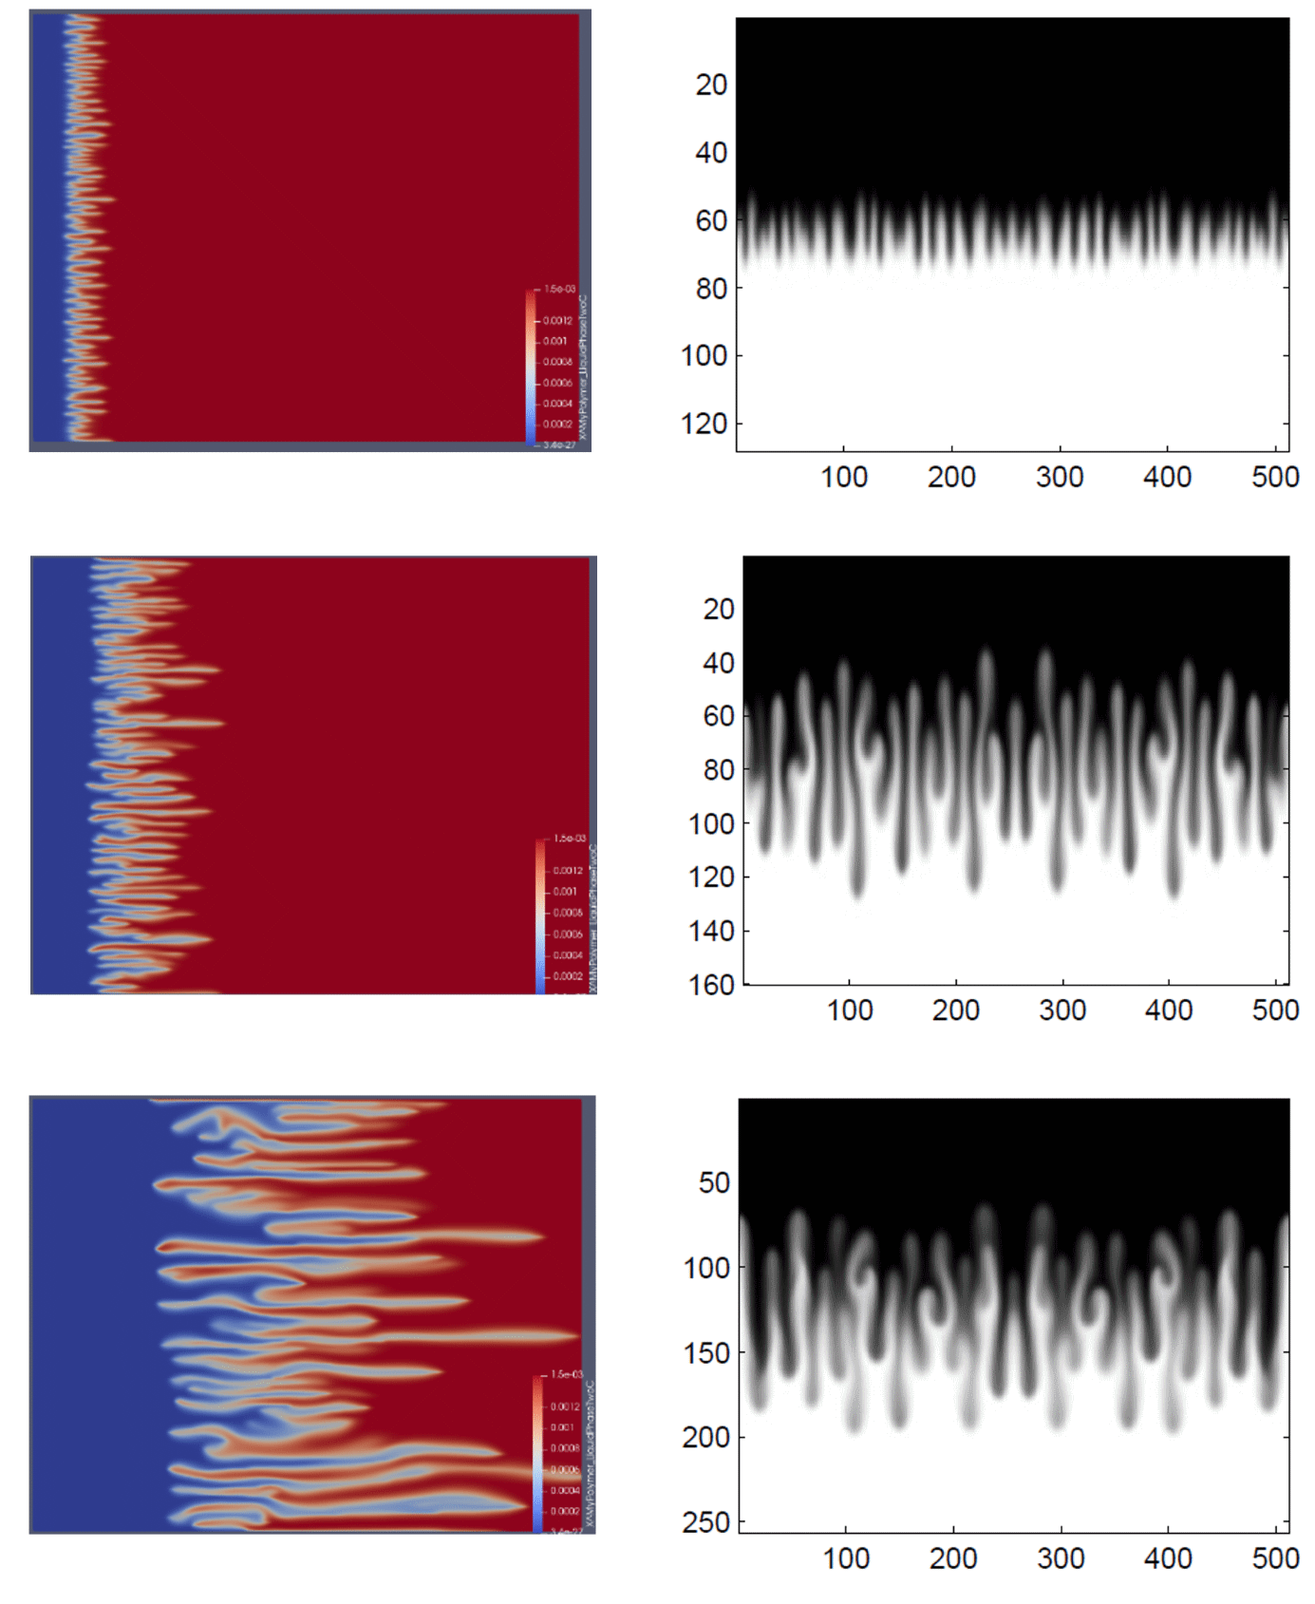
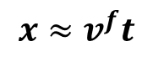
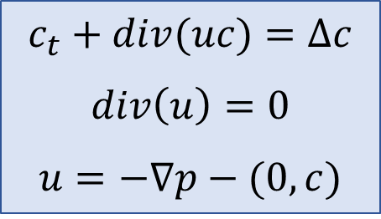
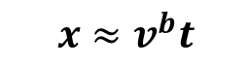
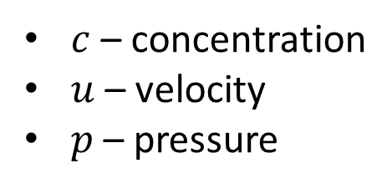

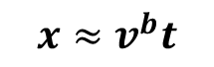
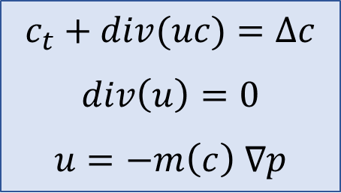

Linear growth of the mixing zone
many laboratory and numerical experiments show linear growth of the mixing zone
$${}^{∗}$$
$$x≈v^{b}t$$
$$x≈v^{f}t$$
Gravitational fingering
PDEs (“black box”):
1
$$x≈v^{f}t$$
$$c_{t}+div(uc)=Δc$$
$$div\left(u\right)=0$$
$$u=−∇p−(0,c)$$
$$c_{t}+div(uc)=Δc$$
$$div\left(u\right)=0$$
$$u=−m\left(c\right) ∇p$$
$c$ – concentration
$u$ – velocity
$p$ – pressure
$$x≈v^{b}t$$
-1
mixing zone
Question: how to find speeds $v^{b}$ and $v^{f}$ of propagation?
Open problem…
* Nijjer J., Hewitt D., and Neufeld J. The dynamics of miscible viscous fingering from onset to shutdown. Journal of Fluid Mechanics 837 (2018): 520-545. * Bakharev, F., Enin, A., Groman, A., Kalyuzhnyuk, A., Matveenko, S., Petrova, Y., Starkov, I. and Tikhomirov, S., 2022. Velocity of viscous fingers in miscible displacement: Comparison with analytical models. Journal of Computational and Applied Mathematics, 402, p.113808.
10

Slide 12
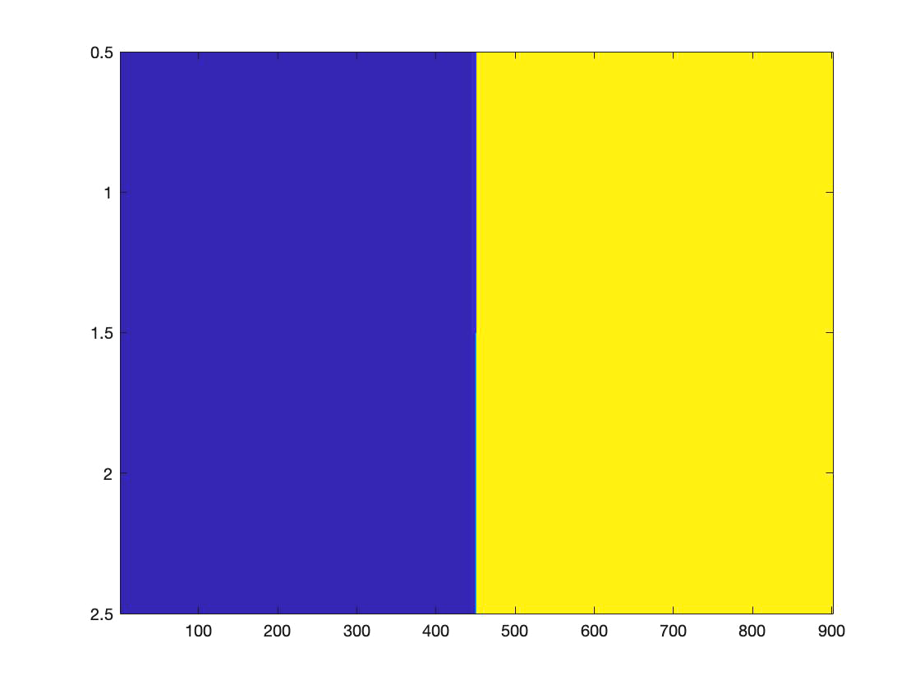
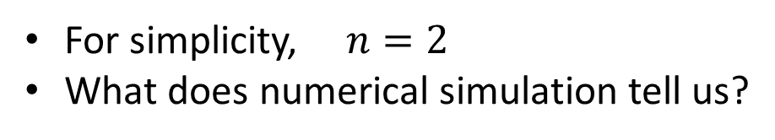
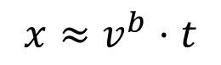
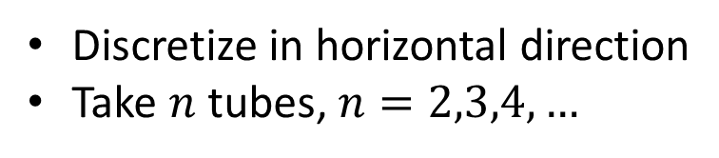
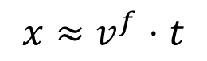

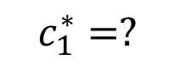
“Toy” model of gravitational fingering
Discretize in horizontal direction
Take $n$ tubes, $n=2,3,4,…$
For simplicity, $n=2$
What does numerical simulation tell us?
1
1
$$x≈v^{f}⋅t$$
$$c_{1}^{∗}=?$$
$$c_{2}^{∗}=?$$
$$x≈v^{b}⋅t$$
-1
-1
As we can observe, there are travelling wave solutions!
Can we rigorously prove their existence?
First, we need to formulate a mathematical model
11

Slide 13











Two-tubes model (with gravity)
Original equation on $c:$
Two-tubes equations on $c$:
$$y$$
$$c_{t}+div\left(uc\right)− ∆c=0$$
$$c_{1}(y, t)$$
$$c_{2}(y, t)$$
$$∂_{t}c_{1}+∂_{y}\left(u_{1}c_{1}\right)−∂_{yy}c_{1}=0$$
$$∂_{t}c_{2}+∂_{y}\left(u_{2}c_{2}\right)−∂_{yy}c_{2}=0$$
$$u_{1}(y, t)$$
$$u_{2}(y, t)$$
$$p_{1}(y, t)$$
$$p_{2}(y, t)$$
12

Slide 14






















Two-tubes model (with gravity)
Original equation on $c:$
Two-tubes equations on $c$:
$$y$$
$$B=\left\{\left.\begin{aligned}−∂_{y}u_{1}⋅c_{1}, ∂_{y}u_{1}<0, \\ +∂_{y}u_{2}⋅c_{2}, ∂_{y}u_{1}>0\end{aligned}\right.\right.$$
$$c_{t}+div\left(uc\right)− ∆c=0$$
$$c_{1}(y, t)$$
$$c_{2}(y, t)$$
$$w⋅c_{1}$$
$$∂_{t}c_{1}+∂_{y}\left(u_{1}c_{1}\right)−∂_{yy}c_{1}=−w⋅c_{1}$$
$$∂_{t}c_{2}+∂_{y}\left(u_{2}c_{2}\right)−∂_{yy}c_{2}=+w⋅c_{1}$$
$$u_{1}(y, t)$$
$$w(y, t)$$
$$u_{2}(y, t)$$
Original equation on $p:$
Two-tubes equations on $p$:
$$u=−∇p −(0,c)$$
$$p_{1}(y, t)$$
$$p_{2}(y, t)$$
$$u_{1}=−∂_{y}p_{1}−c_{1}$$
$$u_{2}=−∂_{y}p_{2}−c_{2}$$
$l$ - parameter
$$w=\frac{p_{2}−p_{1}}{l}$$
Initial condition:
$$c_{1,2}\left(y,0\right)=−1, y<0 \\ c_{1,2}\left(y,0\right)=+1, y>0$$
Original equation on $u$:
Two-tubes equations on $u$:
$$div(u)=0$$
$$w=∂_{y}u_{1}$$
13

Slide 15



Two-tubes model (with gravity)
Original equation on $c:$
Two-tubes equations on $c$:
$$y$$
$$c_{t}+div\left(uc\right)− ∆c=0$$
$$c_{1}(y, t)$$
$$c_{2}(y, t)$$
$$B$$
$$∂_{t}c_{1}+∂_{y}\left(u_{1}c_{1}\right)−∂_{yy}c_{1}=−B$$
$$∂_{t}c_{2}+∂_{y}\left(u_{2}c_{2}\right)−∂_{yy}c_{2}=+B$$
$$u_{1}(y, t)$$
$$w(y, t)$$
$$u_{2}(y, t)$$
Original equation on $p:$
Two-tubes equations on $p$:
$$u=−∇p −(0,c)$$
$$p_{1}(y, t)$$
$$p_{2}(y, t)$$
$$u_{1}=−∂_{y}p_{1}−c_{1}$$
$$u_{2}=−∂_{y}p_{2}−c_{2}$$
$l$ - parameter
$$w=\frac{p_{2}−p_{1}}{l}$$
Original equation on $u$:
Two-tubes equations on $u$:
$$div(u)=0$$
$$B=\left\{\left.\begin{aligned}−w⋅c_{1}, w<0, \\ +w⋅c_{2}, w>0\end{aligned}\right.\right.$$
$$w=∂_{y}u_{1}$$
13

Slide 16




















Main result
The proof is valid only for $l>0$ sufficiently small
Numerics suggests the same statement for $∀l>0$
Moreover, $\lim_{l→0}{c_{1}^{∗}(l)}=−\frac{1}{2}, \lim_{l→0}{c_{2}^{∗}(l)}=\frac{1}{2}$, $\lim_{l→0}{v^{b}(l)}=−\frac{1}{4}, \lim_{l→0}{v^{f}(l)}=\frac{1}{4}.$
A prova tem o “gosto dinâmico”!!
$$∂_{t}c_{1}+∂_{y}\left(u_{1}c_{1}\right)− ∂_{yy}c_{1}=−B$$
$$∂_{t}c_{2}+∂_{y}\left(u_{2}c_{2}\right)− ∂_{yy}c_{2}= B$$
$$B=\left\{\left.\begin{aligned}−∂_{y}u_{1}⋅c_{1}, ∂_{y}u_{1}<0, \\ +∂_{y}u_{2}⋅c_{2}, ∂_{y}u_{1}>0\end{aligned}\right.\right.$$
($∗$)
$$u_{1}=−∂_{y}p_{1}−c_{1}$$
Remark:
$$\lim_{l→0}{c_{1}^{∗}\left(l\right)=−0.5}$$
$$\lim_{l→0}{c_{2}^{∗}\left(l\right)=+0.5}$$
$$\lim_{l→0}{v^{b}\left(l\right)=−0.25}$$
$$\lim_{l→0}{v^{f}\left(l\right)=+0.25}$$
$$u_{2}=−∂_{y}p_{2}−c_{2}$$
$$∂_{y}u_{1}=−∂_{y}u_{2}=\frac{p_{2}−p_{1}}{l}$$
As $t→∞$ we observe:
Theorem (Efendiev, P., Tikhomirov, 2023+)
Consider a two-tube model with gravity $(∗)$.
$$1$$
$$c_{2}^{∗}(l)$$
there exists $c_{1}^{∗}(l), c_{2}^{∗}(l)$
$c_{1}$ - blue
$c_{2}$ - green
Then for all $l>0$ sufficiently small
such that there exist two travelling waves (TW):
$$c_{1}^{∗}(l)$$
TW1 with speed $v^{b}(l)$: $\left(−1, −1\right) → \left(c_{1}^{∗},(l) c_{2}^{∗}(l)\right)$ TW2 with speed $v^{f}\left(l\right)$: $\left(c_{1}^{∗},(l) c_{2}^{∗}(l)\right) → \left(1, 1\right).$
$$−1$$
14

Slide 17









… a vida está russa (…ou ruça?) …
Travelling wave ansatz with fixed $v$:
СПАСИБО за внимание! Приезжайте в гости в Рио-де-Жанейро!
System of ODEs in $ℝ^{6}$:
$$c_{1}\left(t,y\right)=c_{1}\left(y−vt\right)$$
$$c_{2}\left(t,y\right)=c_{2}\left(y−vt\right)$$
$$u_{1}\left(t,y\right)=u_{1}\left(y−vt\right)$$
$$u_{2}\left(t,y\right)=u_{2} \left(y−vt\right)$$
$$p_{1}\left(t,y\right)=p_{1}\left(y−vt\right)$$
$$p_{2}\left(t,y\right)=p_{2}(y−ct)$$
$$\left\{\begin{aligned} \dot{X}=F_{v}(X,Y) \\ ε⋅\dot{Y}=AY−BX\end{aligned}\right.$$
Here:
$X=\left(\begin{aligned}\begin{aligned}c_{1} \\ c_{2} \\ ∂_{ξ}c_{1}\end{aligned} \\ ∂_{ξ}c_{2}\end{aligned}\right)∈ℝ^{4}$, $Y=\left({u_{1} \atop p_{1}−p_{2}}\right)∈ℝ^{2}$
$A=\left(\begin{matrix}0 & 1 \\ 2 & 0\end{matrix}\right)$, $B∈M^{2×4}$, $ε=\sqrt{l}≪1$
With condition at $+∞:$
$$c_{1}\left(+∞\right)=1$$
$$c_{2}\left(+∞\right)=1$$
$$u_{1}\left(+∞\right)=0$$
$$u_{2}\left(+∞\right)=0$$
$$\left(p_{1}−p_{2}\right)\left(+∞\right)=0$$
Aim:
find a heteroclinic orbit $\left(X\left(ξ\right),Y\left(ξ\right)\right), ξ∈ℝ$
such that $\left(X\left(+∞\right), Y\left(+∞\right)\right)=$ given point.
Observation:
for $ε→0$this system has a special ``slow-fast’’ structure. Let me say several words on what is called geometric singular perturbation theory (GSPT)
15

Slide 18














Simple example
Slow system
Fast system
$$t=ε⋅s$$
$$\left\{\begin{aligned} \dot{x} =−x \\ ε⋅\dot{y } =x^{2}−y\end{aligned}\right.$$
$$\left\{\begin{aligned}x^{′} =ε⋅\left(−x\right) \\ { y}^{′} = x^{2}−y \end{aligned}\right.$$
$$0<ε≪1$$
$$ε=0.1$$
$$ε=0.5$$
$$ε=1.5$$
Formally
$$ε→0$$
Formally
$$ε→0$$
Reduced slow system
Reduced fast system
$$\left\{\begin{aligned}\dot{x} = −x \\ 0 = x^{2}−y\end{aligned}\right.$$
$x$ – slow variable
$y$ – fast variable
$S=\left\{x^{2}−y=0\right\}$
$S$ - critical set
$$\left\{\begin{aligned}x^{′} = 0 \\ { y}^{′} = x^{2}−y\end{aligned}\right.$$
16

Slide 19










Geometric singular perturbation theory (GSPT)
Slow system ($t$ – slow time)
Fast system ($s$ – fast time)
$$\left\{\begin{aligned} \dot{X} = F (X,Y,ε) \\ ε⋅\dot{Y } = G(X,Y,ε)\end{aligned}\right.$$
$$t=ε⋅s$$
$$\left\{\begin{aligned}X^{′} = ε⋅F \left(X,Y,ε\right) \\ { Y}^{′} = G\left(X,Y,ε\right) \end{aligned}\right.$$
$$0<ε≪1$$
Formally
$$ε→0$$
Formally
$$ε→0$$
Reduced slow system
Reduced fast system
$$\left\{\begin{aligned} \dot{X} = F \left(X,Y,0\right) \\ 0 = G(X,Y,0)\end{aligned}\right.$$
$$\left\{\begin{aligned}X^{′} = 0 \\ { Y}^{′} = G\left(X,Y,0\right)\end{aligned}\right.$$
$S=\{G\left(X,Y,0\right)=0\}$ – critical set
empty or consists of isolated points
contains a differentiable manifold
(regular perturbation problem)
(singular perturbation problem)
17

Slide 20



Normally hyperbolic manifolds (“fast-slow” version)
$$\left\{\begin{aligned}X^{′} = ε⋅F \left(X,Y,ε\right) \\ { Y}^{′} = G\left(X,Y,ε\right) \end{aligned}\right.$$
$\left(X,Y\right)∈ℝ^{m}×ℝ^{n}$, $F(X,Y,ε)$, $G(X,Y,ε)$ – smooth
$S=\{\left(X,Y\right)∈ℝ^{m+n}: G\left(X,Y,0\right)=0\}$ – critical manifold
Definition: A smooth compact manifold $S_{0}⊂S$ is called normally hyperbolic if
the $n×n$ matrix $DG_{Y}(X,Y,0)$ is hyperbolic for all $\left(X,Y\right)∈S_{0}$.
In particular, $S_{0}$ is called:
- attracting, if all eigenvalues of $DG_{y}(X,Y,0)$ have negative real part
- repelling, if all eigenvalues of $DG_{y}(X,Y,0)$ have positive real part
- of saddle-type, if it is neither attracting nor repelling
Take-home message 2:
Normal hyperbolicity of critical manifold $⇒$ ``nice’’ perturbation
18
Fenichel, N., 1979. Geometric singular perturbation theory for ordinary differential equations. Journal of differential equations, 31(1), pp.53-98.

Slide 21




Fenichel’s theorem (``fast-slow’’ version)
Let $S_{0}$ be a compact normally hyperbolic submanifold (possibly with boundary) of the critical manifold $S$ of the system
and that $F,G∈ C^{r} (r<∞)$.
$$\left\{\begin{aligned}X^{′} = ε⋅F \left(X,Y,ε\right) \\ { Y}^{′} = G\left(X,Y,ε\right) \end{aligned}\right.$$
Then for $ε>0$ sufficiently small, the following hold:
(F1) There exists a locally invariant manifold $S_{ε}$ diffeomorphic to $S_{0}$.
(F2) $S_{ε}$ has Hausdorff distance $O(ε)$ from $S_{0}$ (as $ε → 0$).
(F3) The flow on $S_{ε}$ converges to the flow of the reduced slow system$\left(\text{a}\text{s} ε → 0\right).$
(F4) $S_{ε}$ is $C^{r}$-smooth and normally hyperbolic
Remark: $S_{ε}$ may be not unique
19
Local invariance means that trajectories can enter or leave $S_{ε}$ only through its boundaries.

Slide 22




Travelling wave dynamical system: GSPT
We have:
Critical manifold: $S=\left\{\left(X,Y\right): Y=A^{−1}BX\right\}, \dim{S}=4$
$K⊂S$ (compact) is normally hyperbolic as the matrix $A=\left(\begin{matrix}0 & 1 \\ 2 & 0\end{matrix}\right)$ has eigenvalues $λ_{±}=±\sqrt{2}$
$$\left\{\begin{aligned} \dot{X}=F_{v}(X,Y) \\ ε⋅\dot{Y}=AY−BX\end{aligned}\right.$$
$X∈ℝ^{4}$, $Y∈ℝ^{2}$
Thus, by Fenichel’s theorem:
For any compact submanifold $K⊂S$ there exists a locally invariant manifold $K_{ε}⊂ℝ^{6}$
$K_{ε}=\{\left(X,Y\right): Y=A^{−1}BX+εh(X,ε)\}$ for some smooth function $h$
Result: 6-dim system on $\left(X,Y\right)$ $⇒$ 4-dim system on $X$on $K_{ε}$:
$$\dot{X}=F_{v}(X, A^{−1}BX+εh(X,ε))$$
20

Slide 23







Somos o pé-quente! (=Temos sorte!)
We have a perturbation problem ($X∈ℝ^{4}$):
$ε>0$:
$$\dot{X}=F_{v}(X, A^{−1}BX+εh(X,ε))$$
$ε=0$:
$$\dot{X}=F_{v}\left(X,A^{−1}BX\right)$$
$$\left\{\begin{aligned}\dot{a}=r \\ \dot{b}=s \\ \dot{r}=−vr−\frac{a}{2}(s−r) \\ \dot{s}=−vs−ra \end{aligned}\right.$$
… we can find all heteroclinic orbits explicitly when $ε=0$!...
To prove the existence of heteroclinic orbits for $ε>0$,
você precisa combinar com os russos (não hoje)….
Nunca esqueça de combinar com os russos!
21

Slide 24






What do we NOT know and would be great to know?
1. Does there exist a heteroclinic orbit for this system for arbitrary $l$?
2. Can we generalize the theorem on existence of travelling wave solutions (cascades) for arbitrary number $n$ of tubes?
$$\left\{\begin{aligned}\dot{a}=r \\ \dot{b}=s \\ \dot{r}=−vr+u_{1}s−\frac{aq}{l} \\ \dot{s}=−vs+u_{1}r+\frac{aq}{l} \\ \dot{u_{1}}=\frac{q}{l} \\ \dot{q}=2u_{1}+a \\ \end{aligned}\right.$$
Example for $n=4:$
we observe 4
travelling waves
We have just discussed this system for $l→0$
3. What about studying travelling waves for original 2-dim model? (…infinite dimensional dynamical systems…)
Gravitational fingering
22

Slide 25
References
Muito obrigada pela atenção!
Own works on the topic of the talk:
Bakharev, F., Enin, A., Groman, A., Kalyuzhnyuk, A., Matveenko, S., Petrova, Y., Starkov, I. and Tikhomirov, S., 2022. Velocity of viscous fingers in miscible displacement: Comparison with analytical models. Journal of Computational and Applied Mathematics, 402, p.113808.
Efendiev Ya., Petrova Yu., Tikhomirov S., 2023+, A cascade of two travelling waves in a two-tube model of gravitational fingering. In preparation.
Other references: Dynamics of viscous fingering:
Nijjer J., Hewitt D., and Neufeld J. The dynamics of miscible viscous fingering from onset to shutdown. Journal of Fluid Mechanics 837 (2018): 520-545.
Menon, G. and Otto, F., 2006. Diffusive slowdown in miscible viscous fingering. Communications in Mathematical Sciences, 4(1), pp.267-273.
Menon, G. and Otto, F., 2005. Dynamic scaling in miscible viscous fingering. Communications in mathematical physics, 257, pp.303-317.
Homsy, G.M., 1987. Viscous fingering in porous media. Annual review of fluid mechanics, 19(1), pp.271-311.
23

Slide 26
References
Muito obrigada pela atenção!
Online simulations of ODEs and PDEs:
One-dimensional Fisher KPP: https://visualpde.com/sim/?preset=travellingWave1D
ODE’s: https://anvaka.github.io/fieldplay
Geometric singular perturbation theory (GSPT):
Fenichel, N., 1979. Geometric singular perturbation theory for ordinary differential equations. Journal of differential equations, 31(1), pp.53-98.
Jones, C.K., 1995. Geometric singular perturbation theory. Dynamical Systems: Lectures Given at the 2nd Session of the Centro Internazionale Matematico Estivo (CIME) held in Montecatini Terme, Italy, June 13–22, 1994, pp.44-118.
Wechselberger, M., 2020. Geometric singular perturbation theory beyond the standard form (Vol. 6). New York: Springer.
Kuehn, C., 2015. Multiple time scale dynamics (Vol. 191). Berlin: Springer.
Fisher-KPP equation:
Fisher, R.A., 1937. The wave of advance of advantageous genes. Annals of eugenics, 7(4), pp.355-369.
A.N. Kolmogorov, I.G. Petrovskii and N.S. Piskunov, ́ Etude de l’e ́quation de la diffusion avec croissance de la quantite ́ de matie `re et son application `a un proble `me biologique, Bull. Univ. ́ Etat Moscou, Se ́r. Inter. A 1, 1937, 1–26.
24

